Slide 1
WebEx Remote Access Training
hosted By
ProTech Training

Slide 2
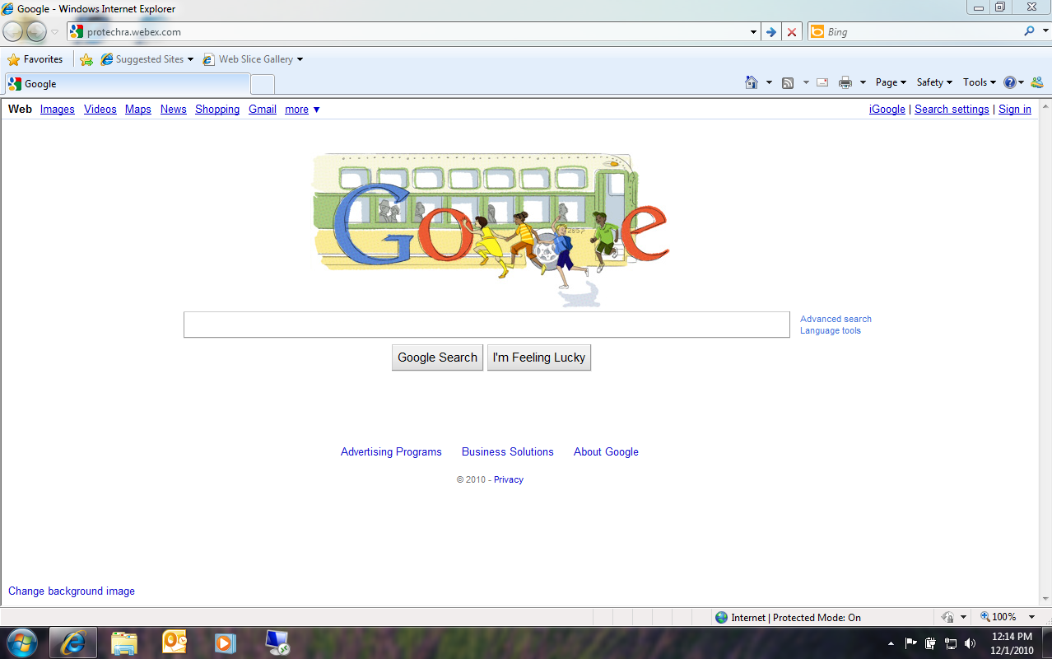
Open your web browser and navigate to
protechra.webex.com

Slide 3
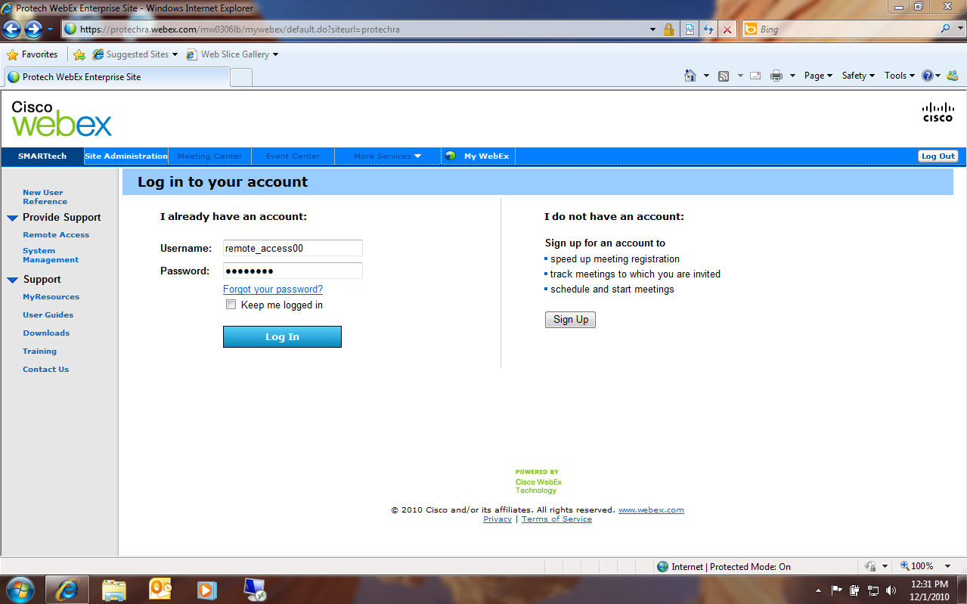
Enter in your username and password.
Your instructor will provide each student with a unique username.

Slide 4
Refresh Button
Click on “Connect” to access your lab computer via WebEx. If your lab computer does not display a “Connect” status, attempt to refresh the status. If this does not correct the problem, please notify your instructor.

Slide 5
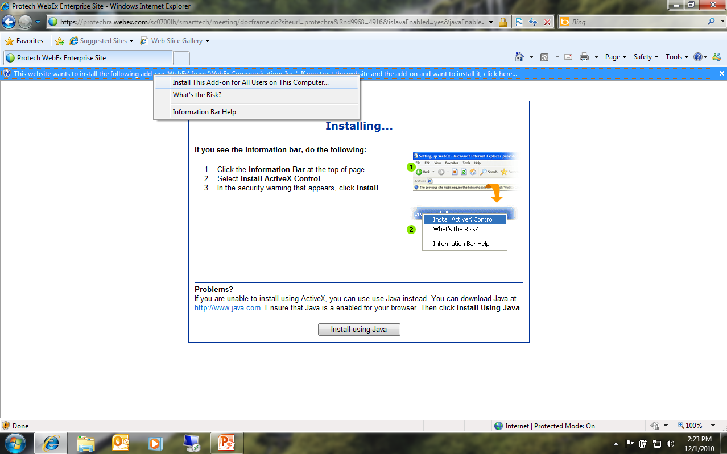
Click
and
Select
Java install also available.
If your bowser displays a security message in a yellow bar, click the bar and choose “Install This Add-on for All users on This Computer…”

Slide 6
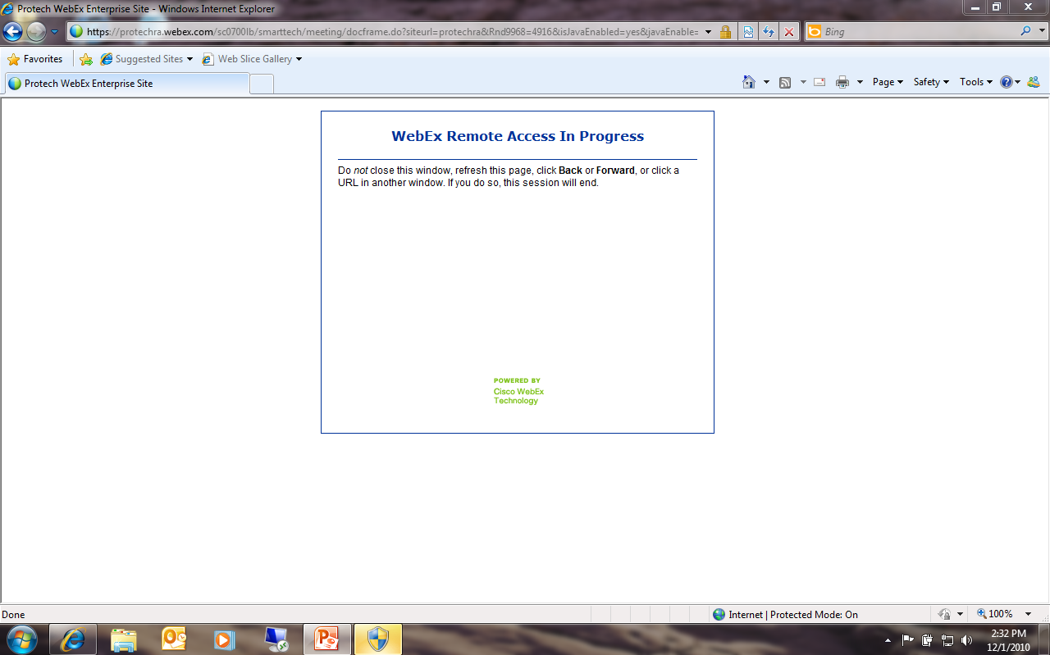
UAC Authorization
If you are using Windows Vista or Windows 7, you may be notified more than once by the User Access Control (UAC) to authorize the installation of the add-on. Your notification may also only show up in your taskbar. Choose “Yes” at the prompt to authorize and continue the installation.

Slide 7
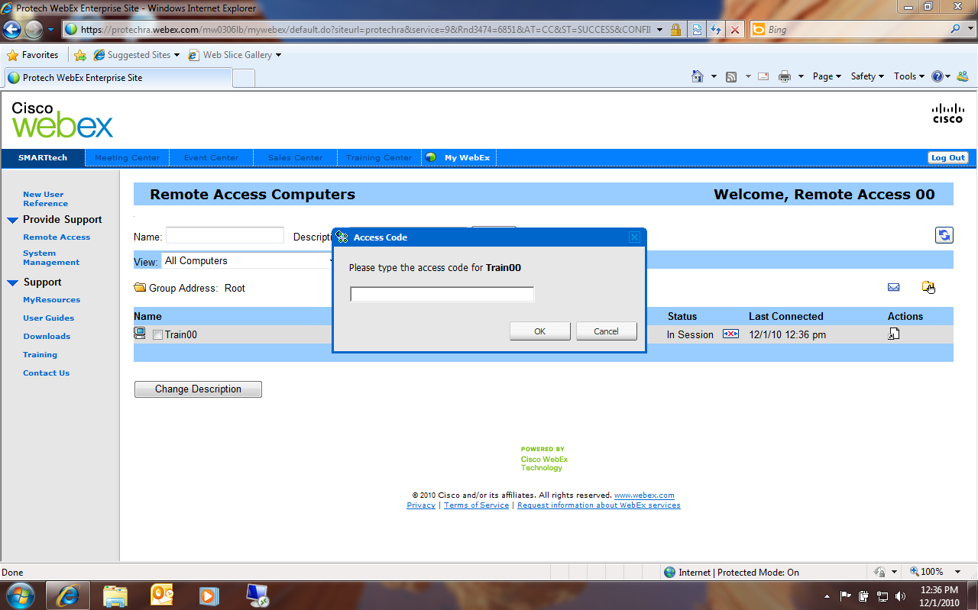
Enter in the access code for your lab computer. The access code will be identical to the password you have just entered, unless specified by your instructor.

Slide 8
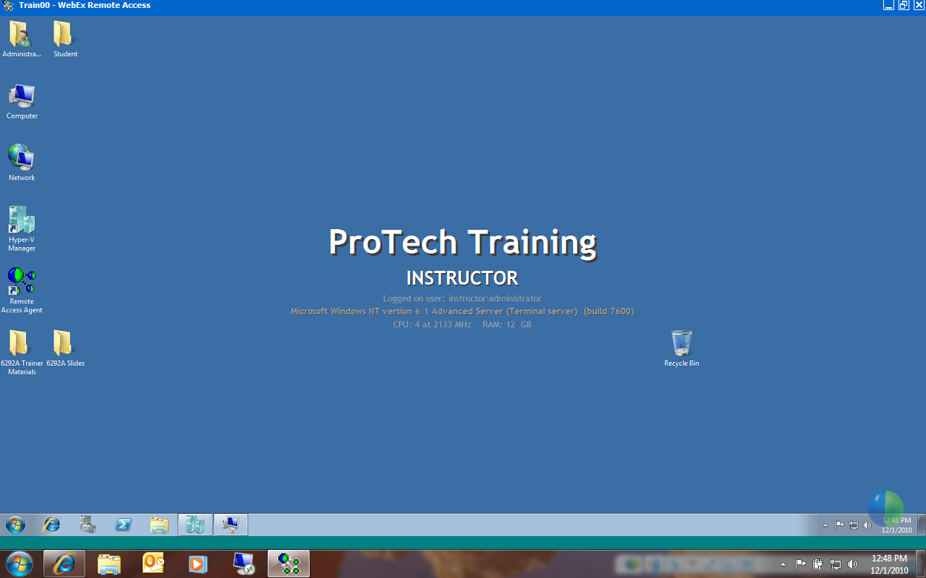
Lab Computer Information
This is your WebEx connection to your lab computer’s host operating system. The host operating system may be different based on the course your are participating in. The background of your lab computer will display “ProTech Training”, the computer name, and additional software and hardware information about your lab computer.

Slide 9
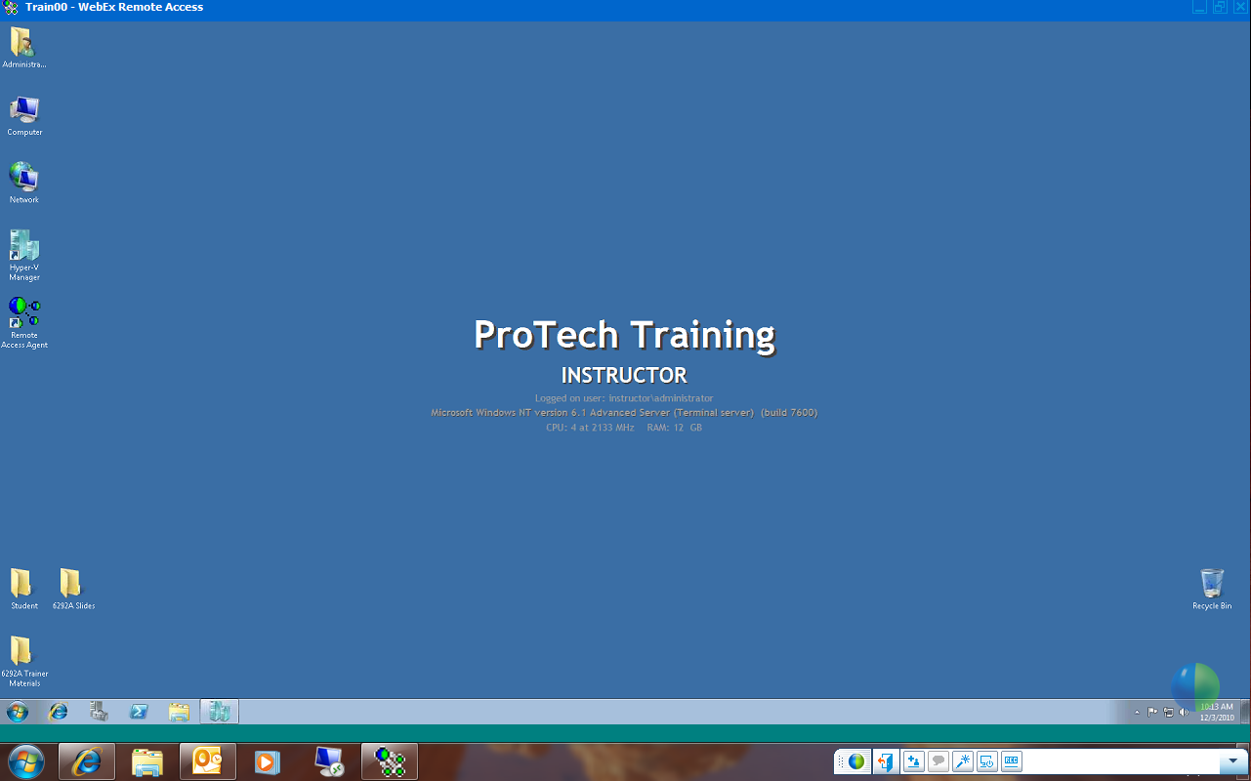
WebEx Menu
ProTech Training provides 24” widescreen monitors for their live students. However, the screen resolution our monitors use may not be suitable for our WebEx remote students. WebEx can automatically set your screen resolution that is suitable for the computer you are using. Select the dropdown arrow to see a list of WebEx functions.

Slide 10
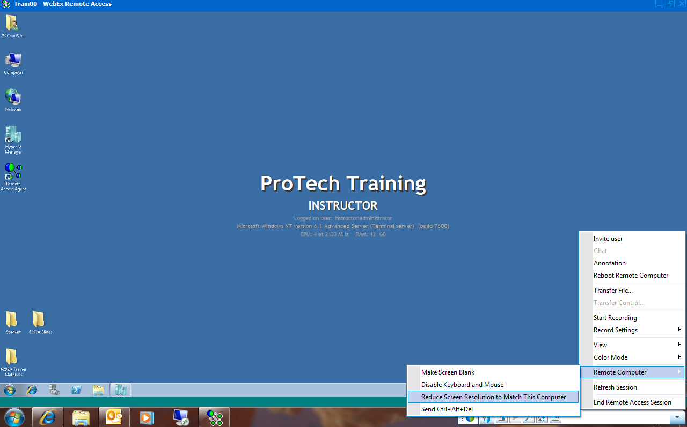
To reduce your lab computer screen resolution to match your local machine’s resolution, select “Remote Computer” → “Reduce Screen Resolution to Match This Computer”. You can also view other menu options from the WebEx control menu at this time.

Slide 11
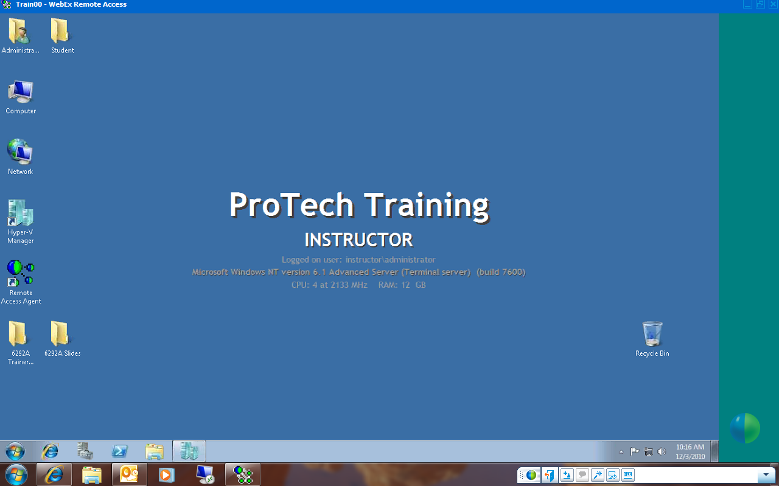
Your lab computer resolution should now be set to match your local computer’s resolution.

Slide 12
To disconnect your WebEx session, simply close the WebEx session window here.
This is your remote host operating system which manages the virtual machines you will use for training.
Do not log off or shut down the host operating system! If this occurs, you will lose connection to your remote WebEx session.
Because many courses have been developed using virtual machines, it is important understand which environment your are controlling when performing tasks. For example, if you want to log off or shut down a virtual machine, and accidentally perform this function on the host operating system of your lab computer, you will lose your WebEx connectivity. This usually occurs when students run virtual machines in full screen mode, switch back and forth between the host and virtual operating systems, and mistakenly shut down or log off of the host instead of the virtual machine.

Slide 13
Your instructor will now cover the functionality of the virtualization software you will be using for this course.

